Slide 1
Intent-Driven Spatial Search Engine using a Hybrid NL-to-SQL Architecture
Submitted By:
Mayank Pillai
Submitted To:
Prof. Yashvardhan Sharma

Slide 2
Table of contents
Project Overview & Problem Statement
Environment Setup
Dataset Curation & Methodology
The Hybrid Evaluation Framework
Testing the AI: Text-to-SQL Performance
Cross-Campus Evaluation
Testing the Translation AI
Testing Speech Recognition (ASR)
The 100% Offline Architecture Flow
Conclusion & Future Work

Slide 3
Project Overview & Problem Statement
The Problem: Traditional digital maps (like Google Maps or Nominatim) suffer from Exact-Match Bias. People naturally search for places based on their needs, but traditional maps rely on formal business names or perfectly structured addresses.
A search for "a quiet place to study" fails because the map literally looks for a business named "Quiet".
The Solution: We built an AI-driven engine that abandons rigid keyword matching. We use Large Language Models (LLMs) to translate abstract human needs into spatial database commands (PostGIS SQL).
The AI dynamically maps abstract concepts (like "study") to specific database tags (like amenity = library).
It translates relative spatial constraints (like "near the library") into spatial functions (like ST_DWithin).
Result: By writing real database code, our system combines the smart, human-like understanding of an AI with the exact, flawless precision of a digital map.

Slide 4
Environment Setup
Hardware Environment:
Local Mac / Colab (T4 GPU): Strict memory limits meant we had to carefully manage resources to run multiple AI models at the same time.
Software Environment:
llama.cpp: Used to run highly compressed 4-bit GGUF language models locally to save memory.
Qwen2.5-Coder (7B): The core engine used for both intent-routing and generating strict PostGIS SQL.
SeamlessM4T v2: Used for offline voice recognition (ASR) and translation.
GeoPandas & Folium: Used for intercepting raw database binaries and rendering live, interactive web maps.

Slide 5
Dataset Curation & Methodology
The Challenge: AI models are often evaluated on simple text, but we needed to test complex spatial reasoning and regional language comprehension. Our Custom Datasets:
The Spatial Database: We extracted a live, 3km radius of OpenStreetMap data around IIT Bombay and BITS Pilani and stored it in a local PostgreSQL database.
The Golden Benchmark (50 Queries): Carefully categorized spatial questions spanning 5 distinct difficulty levels, ranging from simple lookups to advanced geographic constraints (e.g., "Find a cafe within 500m of the library").
The Generalization Benchmark (80 Queries): A completely separate dataset built on the BITS Pilani map to prove our results weren't geographically biased, and that the AI's spatial reasoning works on any city layout.
The Multilingual Set (56 Text & Audio Queries): Complex text and spoken queries crossing Hindi, Tamil, Telugu, Marathi, and Punjabi (including internet slang and Hinglish).

Slide 6
The Hybrid Evaluation Framework
The Challenge: It is notoriously difficult to grade an AI on writing SQL code, because two completely different pieces of code can sometimes return the exact same correct data.
The Solution: We built a custom, two-step "Hybrid Evaluation Framework" to rigorously and safely grade the AI:
Step 1 (Structural Code Check): Before running the code, we parse it into an Abstract Syntax Tree (AST) to securely inspect the SELECT, FROM, and WHERE clauses, along with Logical Operators, ORDER BY sorting, LIMIT constraints, and Spatial Functions.
Step 2 (Live Database Execution): If the code is safe, we execute it live on the Postgres database. We then use the "50% Rule"—if the AI's results achieve an F1 Score of at least 50% (combining both precision and recall against the true target locations), it receives a PASS.

Slide 7
Testing the AI: Text-to-SQL Performance
Model | Pass Rate | Fail Rate | Avg Struct Score | Avg F1 Score
Qwen2.5-Coder-7B-Instruct | 78.0% (39/50) | 4.0% (2/50) | 0.854 | 0.780
SQLCoder-8B (llama-3) | 46.0% (23/50) | 54.0% (27/50) | 0.600 | 0.459
CodeS-7B (BIRD Champ) | 32.0% (16/50) | 68.0% (34/50) | 0.697 | 0.385
DeepSeek-Coder-7B | 28.0% (14/50) | 72.0% (36/50) | 0.489 | 0.297

Slide 8
Model Selection & Root Cause Analysis
Why did the other models fail?
CodeS & DeepSeek: Both models failed miserably (32% and 28%). Because they were aggressively fine-tuned on complex corporate schemas, they overcomplicated our simple map data and hallucinated non-existent columns (like "address").
SQLCoder: Suffered from fatal weaknesses. It mapped wrong columns without explicit hints (mapping "library" to leisure instead of amenity), struggled with negation, and completely broke down on spatial JOINs.
The Winner (Qwen2.5-Coder): Naturally understood map concepts, generating clean spatial code without hallucinating.

Slide 9
Cross-Campus Evaluation
The Evaluation: To ensure our results were not geographically biased, we ran a second, larger evaluation (80 queries) on a completely different map structure (the BITS Pilani campus).
The Conclusion: Qwen2.5-Coder maintained a dominant 71.2% pass rate, proving its spatial reasoning flawlessly generalizes to unseen geographies without any fine-tuning. Meanwhile, models trained strictly on corporate databases (like CodeS) collapsed completely to 23.8% when exposed to new geographic constraints.
Final Recommendation: Qwen2.5-Coder-7B-Instruct is the definitively recommended model for text-to-SQL spatial logic.

Slide 10
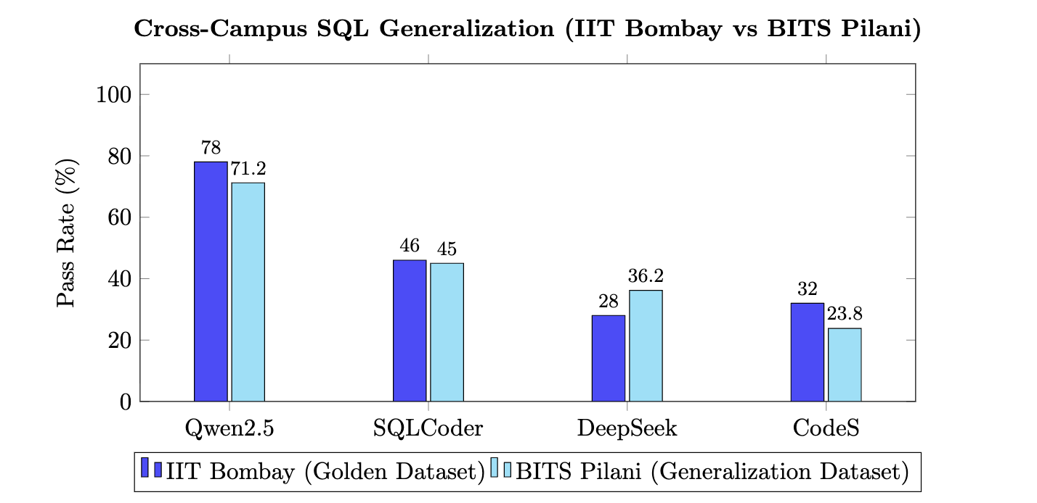
Cross-Campus SQL Generalization
Comparing model robustness across two completely different geographic environments:

Slide 11
Testing the Translation AI
The Challenge: Since our SQL AI only speaks English, we needed a text translator for our Indian users that could handle conversational Hinglish. Why did the other models fail?
Google Translate (The Cloud Baseline): Performed the best overall (96.4%), but since our goal is a 100% offline architecture, we could not rely on a cloud API.
NLLB-200 & SeamlessM4T: Completely failed on internet slang. They would often just repeat the Hindi slang word back in English letters (leaving words like "tapri" untranslated), which caused the SQL AI to crash.
Sarvam-Translate (The Winner): Flawlessly translated messy slang into proper English. It is a bit "chatty" (trying to hold a conversation instead of just translating), but we fixed this with a strict prompt to force it to behave.
Final Recommendation: Sarvam-Translate (4B) is our official choice for translating messy text.

Slide 12
Translation Model Performance
Model | Overall Pass Rate | Hinglish/Slang Pass Rate | Total SQL Failures
Google Translate (Cloud Baseline) | 96.4% | 71.4% | 0
Sarvam-Translate (4B) | 87.5% | 71.4% | 2
NLLB-200 (1.3B) | 85.7% | 57.1% | 3
SeamlessM4T v2 (Large) | 83.9% | 42.9% | High

Slide 13
Testing Speech Recognition (ASR)
The Challenge: To allow users to literally speak to the map, we tested four different voice recognition engines using our synthetic audio dataset. Why did the other models fail?
OpenAI Whisper (Failed): Despite being famous, Whisper was terrible at understanding regional Indian languages, completely failing on Telugu and Marathi.
Google Speech (Failed): Google was decent, but completely broke down when a user mixed Hindi and English in the same sentence.
Sarvam API (Runner-Up): Incredibly accurate, but it requires an internet connection to use their API, which breaks our "100% offline" goal.
SeamlessM4T v2 (The Winner): Listened to Indian audio and translated it directly into English text in a single step, entirely offline on our local GPU.
Final Recommendation: SeamlessM4T v2 is our official choice for the voice engine because it is fast, accurate, and runs 100% offline.

Slide 14
ASR Model Performance
Model | Pass Rate | Avg Word Error Rate (WER) | Type
Sarvam API (Saaras) | 83.9% (47/56) | 0.339 | Cloud API
SeamlessM4T v2 (Large) | 82.1% (46/56) | 0.470 | Local / Open
Google Speech Recognition | 78.6% (44/56) | 0.514 | Cloud API
OpenAI Whisper (Large) | 66.1% (37/56) | 0.632 | Local / Open

Slide 15
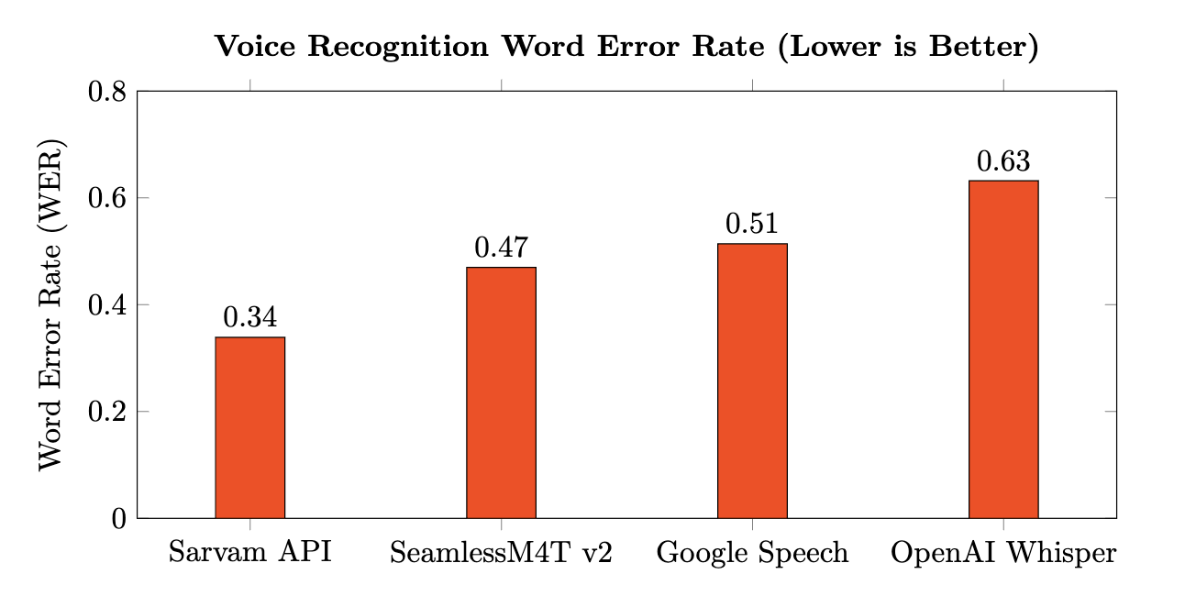
ASR Model Performance

Slide 16
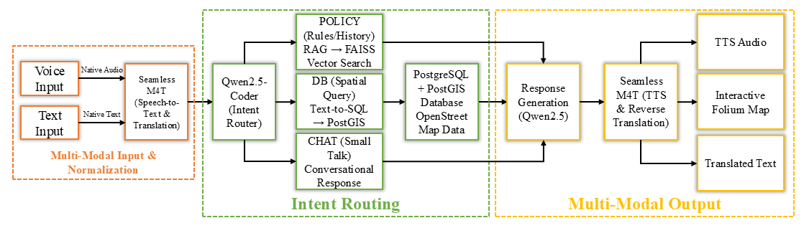
The 100% Offline Architecture Flow
The Goal: Run the entire ecosystem locally without relying on Cloud APIs that pose privacy risks and have strict rate limits.
How data flows through the system:
User Input: User inputs a query via voice (audio) or text in their native regional language.
Translation to English: SeamlessM4T transcribes and translates both the audio and text directly into English.
Intent Router: Qwen2.5 filters out small talk and decides if the query requires a Database Search or a RAG Rulebook search.
Generating SQL: Qwen translates the English intent into an executable spatial SQL query.
Database Search: Local PostgreSQL map is queried.
Reverse Translation & Output: The results are summarized in English, translated back to the native language via SeamlessM4T, and outputted as text and spoken aloud!

Slide 17
Conclusion & Future Work
Final Takeaways:
Successfully replaced rigid keyword searching with an AI that understands abstract human intent.
Built a highly accurate, custom Hybrid Evaluation Framework to prove model reliability.
Achieved a highly accurate, privacy-first system running 100% offline.
Future Enhancements:
Real-Time Latency: Integrating vLLM engines to speed up generation times.
State Memory: Upgrading the AI to remember context from earlier in the conversation.
Live Phone GPS: Automatically hooking into the user's real-time mobile location data.

Slide 18


